Slide 1
BIRDWOOD HIGH SCHOOL
COURSE COUNSELLING
2023 FOR 2024/25

Slide 2
Acknowledgement of Country
I would like to acknowledge we are on the lands of the Peramangk people.
The Peramangk people have walked these lands for thousands of years, they are still physically and spiritually connected to these lands, skies and waters.
I pay respect to the Elders past, present and emerging.
I also acknowledge the other Aboriginal people present here today and their connection to this country.
I want to acknowledge the aboriginal students here today and recognise they are our future leaders and emerging elders.
We are blessed to share a land that was never ceded and should continue to care for this country for future generations.
Thank you.

Slide 3
Thanks for attending tonight
Presenters:
Mark Hodgson Principal
Ashley Fowler Senior School Leader
Richard Hollands SACE/VET/Year 11 manager

Slide 4
Information to consider:
The SACE
Future pathways

Slide 5
The process:
Connected Learning sessions over 5 weeks for students to get information and research
Course confirmation day Tuesday 29 August
Year 10 and year 11 do a course presentation (part of PLP for year 10s)

Slide 6
Course Confirmation day:
You will shortly receive information on how to make an appointment for a parent or caregiver to come in with your child for a 10 minute appointment for the student to lead a discussion on their possible future career pathway and the subjects that they would like to do to get there.
Appointments will run from 10am to 7pm

Slide 7
SACE
Capabilities and the Learner Profile
SACE are in the process of introducing a measure of student capabilities alongside academic achievement (grades) to provide a more holistic view of an individual students’ achievements.
5 Capabilities are:
Self-Motivated Learning
Quality Thinking
Collective Engagement
Principled Action
Personal Enterprise
The Learner Profile will provide a demonstration of student’s capabilities to enable them to better match with potential employers and further education providers.

Slide 8
SACE
Personal learning plan (PLP)
completed in year 10 at BHS
compulsory subject
first step in gaining the SACE
worth 10 credits
Stage 1 level (first stage of SACE)
C grade or better needed
year 10’s who do not complete will remain at school until successfully completed at the end of the year.

Slide 9
Stage 1 compulsory subjects
At Stage 1 students must successfully complete compulsory subjects
Personal learning plan (10 credits)
literacy (at least 20 credits from range of English subjects or courses)
numeracy (at least 10 credits from a range of mathematic subjects or courses)

Slide 10
Assessment at Stage 1
subjects are graded from A to E
all tasks are assessed by teachers at the school
assessment can be externally checked (moderated) in Mathematics, English and the Personal Learning Plan

Slide 11
Stage 2 compulsory subjects
At stage 2
Students must successfully complete at least 60 credits (3 full-year subjects)
Stage 2 Research project

Slide 12
Research project - compulsory subject
worth 10 credits
Stage 2 level
C band grade or better needed
can be included in the ATAR for university entry
completed in year 11 at BHS

Slide 13
Additional subjects
in addition, students must choose and complete at least 90 credits of additional subjects
this will bring the total number of credits to at least 200
maybe at Stage 1 or Stage 2 level

Slide 14
Assessment at Stage 2
subjects are graded from A⁺ to E⁻
70% of subject assessments (e.g. assignments) will be assessed by the student’s teacher and moderated by the SACE Board
30% of subject assessments (e.g. investigations, exams) will be assessed externally by a SACE Board assessor

Slide 15
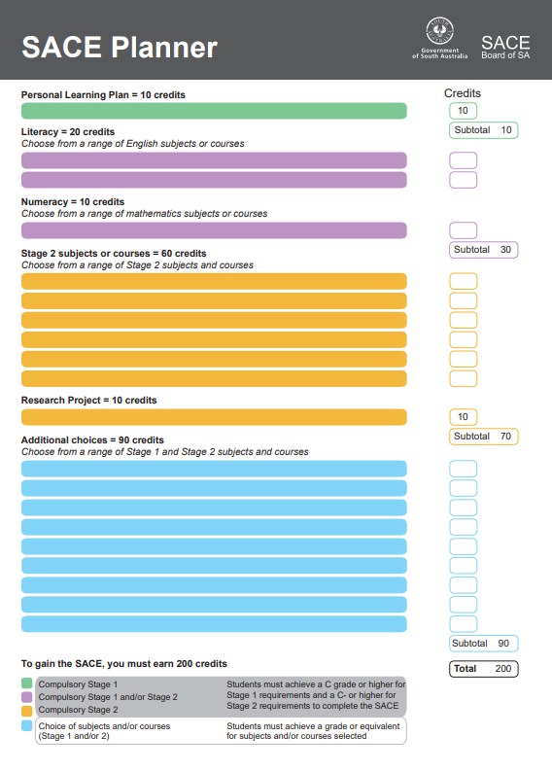

Slide 16
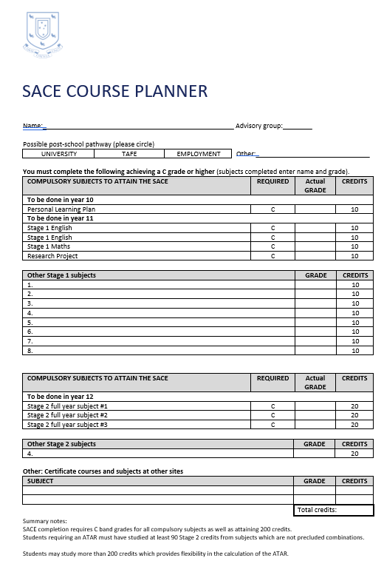
SACE pattern at BHS

Slide 17
Recognised learning
The SACE recognises learning both in and outside school, for example:
Vocational Education and Training courses (VET)
University and TAFE courses and those offered by other reputable registered training organisations
community learning (such as Duke of Edinburgh’s Award or volunteer work)

Slide 18
Vocational Education and Training (VET)
Nationally recognised competency-based training
Pathways for students wishing to enter the workforce
VET qualifications can contribute to SACE completion
VET forms part of an apprenticeship, traineeship or School-Based apprenticeship or traineeship (SBAT)
VET can contribute to gaining an ATAR (University Entrance)
Give you skills and experience that will be *critical* for jobs of the future
70% of jobs in the future will require a minimum Certificate III or higher
Give you skills and experience that most people don’t have!

Slide 19
How is VET offered?
Range of choices in courses offered at Birdwood, include Bakery, Screen and Media, Engineering (new pathway)
Other course options also available across Adelaide Hills
2024 | ahsps2 – Course listing
Students must undertake a VET Readiness Orientation (VETRO) process
3 step process to access VET
VET fees do apply – these are heavily subsidised and additional funding support is available through school(s)
VET can alter a students timetable – may require catchup work to be done

Slide 20
School based apprenticeships/traineeships - SBATS
A contract of employment between an employer, an employee and a training organisation​
SBATs can be commenced in year 10, 11 or 12
SBATs can enable a student to complete SACE whilst learning a trade / profession
LEARN & EARN!!
If students complete compulsory SACE subjects, can potentially work full-time
check Daymap for advertisements
check seek.com etc for advertisements
Consider Group Training Organisations

Slide 21
Post school options
possible future pathways affect subject choices
consider requirements for courses you are interested in
Post school transition into full-time apprenticeship / traineeship
check online – TAFE SA, universities, SATAC

Slide 22
Australian tertiary admissions rank
(ATAR)
a measure of a student’s overall achievement in the SACE compared with other students
used by universities in the selection of school leavers for a place in courses
ranges from 0 to 99.95
calculated from university aggregate, based on 4 full-year tertiary admissions subjects (TAS) plus 1 half year TAS, or other studies recognised by the SACE Board and universities ie out of 90

Slide 23
2024 university entry

Slide 24
University
Students will need to:
complete the SACE
gain an ATAR
gain a university aggregate
complete pre-requisites for some courses
comply with rules regarding subject combinations and counting restrictions
check details in SATAC Uni guide or on SATAC website

Slide 25
Bonus Points
South Australian universities equity scheme
Individual bonuses for students based on school card, Centrelink means-tested income support payment, health care card (up to 5 points)
Language and Maths bonus points – LOTE, English Studies or Communications, Maths Studies, Specialist Maths with C- grade or better (up to 4 points)
Bonus points are added to the aggregate

Slide 26
TAFE and other RTOs
all TAFE information is online
check website for TAFE SA www.tafesa.edu.au
competitive and non competitive courses
apply for via TAFE website
contact other RTOs and check details carefully

Slide 27
Can students do any subject they want?
Course counselling process encourages students to choose relevant subjects. Selected courses should support career pathways.
BHS uses subject recommendations
There are some counting restrictions for students wanting to attend University

Slide 28
the curriculum guide is on the schools website and has been sent to all students in a Daymap message. Parents will also receive this via email.
forms have been distributed to students to do some planning
preferential order of subjects is important
using subject recommendations is important
some courses have associated costs
reserve choice is important, it may be allocated to students

Slide 29
Online selections
all students will be selecting their subjects on-line using web preferences.
information will go out to students/families in week 3 regarding this process.
we want students to consider their career choices and subjects to support that choice, rather than subjects without a plan.

Slide 30
Further information

Slide 31
Further career information
Students can access studentpathways.sa.edu.au
There is more information with links to career information, university and TAFE websites.
Attend open days

Slide 32
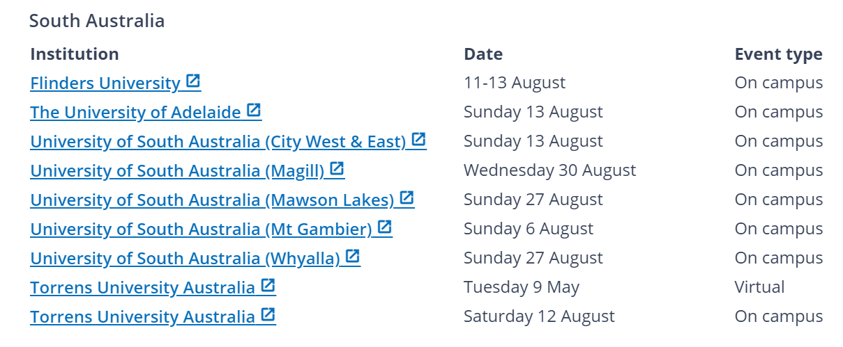

Slide 33
Questions?
Thank you for attending!

